Slide 1
CIS MINOR
COMPUTER AND INFORMATION SCIENCE
Minor
Notes:
Created and revised by LaNorris D. Alexander, Aug, 2019

Slide 2
In this Session…
Requirements for the CIS Minor
C++ pathway
Java pathway
Technical Elective Options
How to declare the minor
Notes:
In this session we will detail the requirements for the CIS Minor. This minor offers a focus in program and software for students with an interested in Computer Sciences at The Ohio State University.

Slide 3
Pathways in CIS Minor
C++
CSE 1222
CSE 2122 (3)
CSE 2321 (3)
CSE 3430 (3)
6 hrs Electives
Java
CSE 1223
CSE 2123 (3)
CSE 2321 (3)
CSE 3430 (3)
6 hrs Electives
Notes:
The CIS Minor requires 16credit hours of coursework
There are two pathways into the CIS Minor: C++ or Java.
CSE 1222 is the prerequisite for the C++ pathway and CSE 1223 is the prerequisite for the Java pathway
CSE 2122 follows 1222 and 2123 follows 1223.
Both require successful coursework in:
Foundations 1: Discrete Structures
Social, Ethical, and Professional Issues in Computing
Overview of Computer Systems for Non-Majors
Six credit hours of technical electives to complete the minor

Slide 4
Technical Elective Options
CSE 2133 (Java track only)
CSE 2331 (requires Stat 2450 or higher)
CSE 3241
CSE 4471
CSE 5052
2hr of CSE 4251 – 4256
Notes:
These courses are recommended and reserve space for students in the CIS minor.
You may consider taking other CSE 3000+ courses. Please note, space in other courses is reserved for CSE/CIS majors and is extremely limited. Majors with specializations tend to fill these class seats.

Slide 5
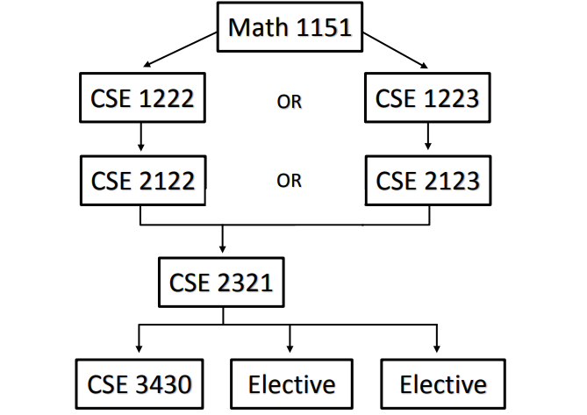
CIS MINOR CURRICULUM

Slide 6
Declaring the CIS Minor
After reviewing this presentation, you can ugadvising@cse.ohio-state.edu to declare the CIS minor.
Notes:
Never too early to start thinking about it
Undergraduate research is a HUGE opportunity to help you prepare for graduate school, but ALSO helps you with additional critical thinking skills that the industry wants, as well, in case you end up not going. So no downside! If you’re not sure, undergraduate research will help you either way – opens doors. Great job! You’re here – already doing it!
Undergraduate research is #1 factor for PhD applications – we don’t want to admit a student to a PhD without an understanding of what it’s like to be in a lab setting, then students get here and decide they don’t like it, not what they expected. Good way to test the waters to see if you like working in a lab and doing research. See if it’s interesting.
SROP is across all Big Ten schools
Great place to start => Eng website, Academics tab, “Undergraduate” – Undergrad Research
Your own academic advisor
NSF
Pathways to Science

